Slide 1
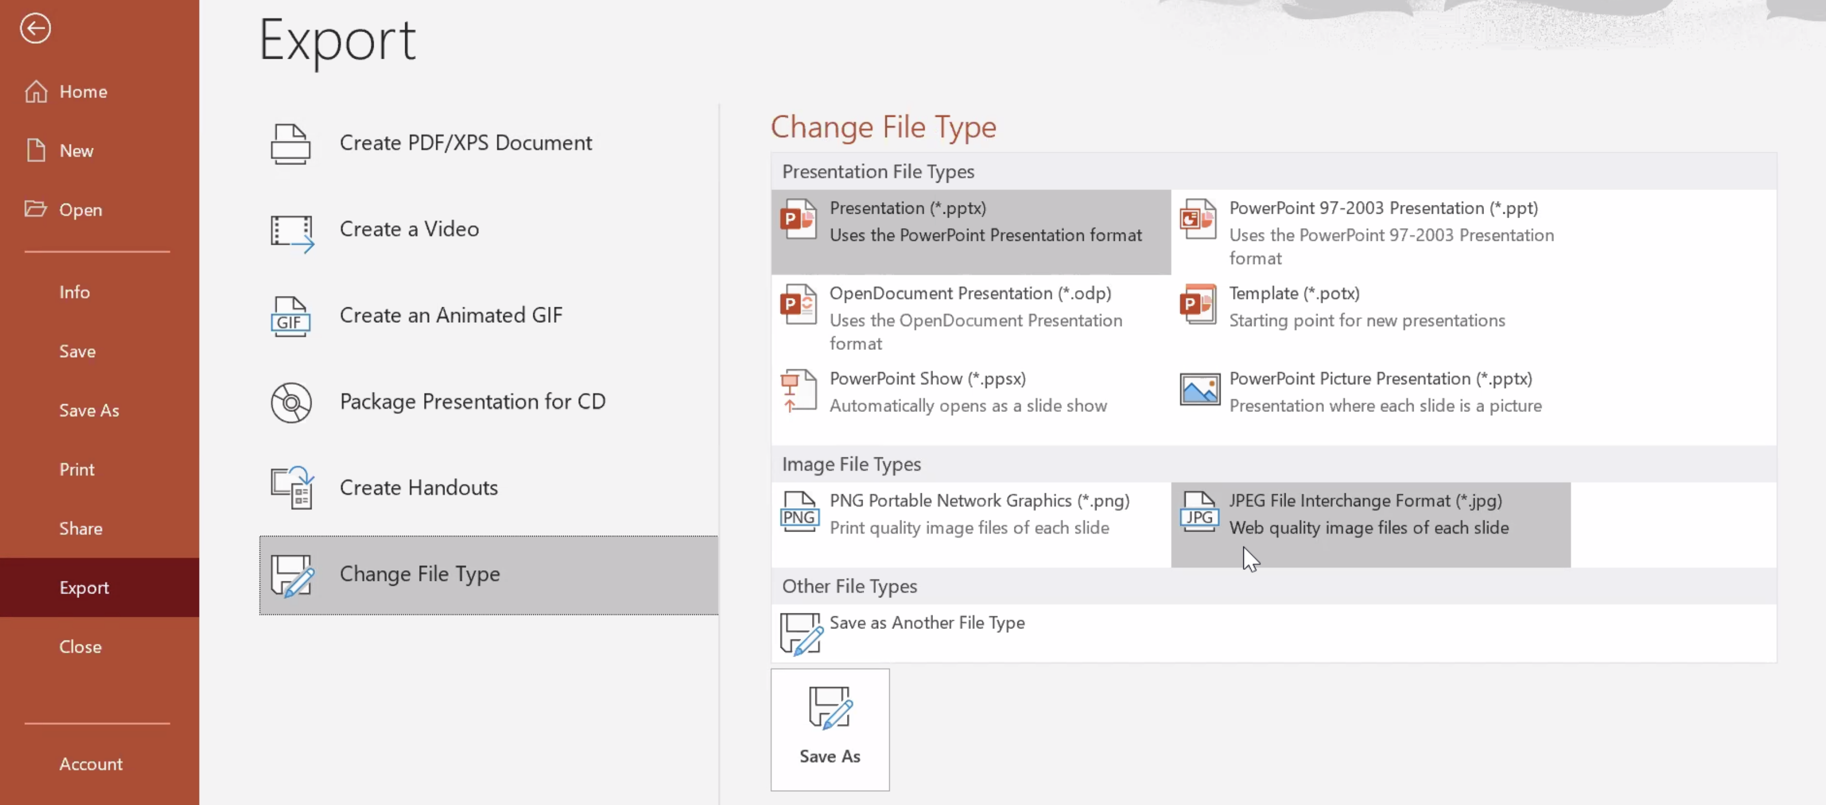
How to create a customized Rotary club, district, or zone virtual meeting background.
Use the Logo Template Tool on Rotary’s Brand Center to create your club, district, or zone logo. Save the logo as a PNG file.
Insert your club, district, or zone logo into the slide.
Scale your logo so it’s the same size as the template’s placeholder logos (those that say “Club of Some City”).
Copy and paste your logo throughout the slide, using the template’s placeholder logos as reference.
Delete the template’s placeholder logos. Now, only your Rotary club, district, or zone logo remains.
For PC: Save the slide by selecting: File > Export > Change File Type and choose JPEG. (See screenshot below.)
For Mac: Save the slide by selecting: Export > JPG > enter width: 1920, enter height: 1080.
Upload the JPG to your virtual meeting platform. You now have a digital background for your next virtual meeting!

Slide 7
Rotary Leadership Institute

